Slide 1
COMP 4332 / RMBI 4310 Big Data Mining (Spring 2019)
Tutorial 2: Convolutional Neural Network
TA: Haojie Pan (hpanad@connect.ust.hk)

Slide 2
Recall last tutorial
1
T
Perceptron
Multi Layer Perceptron
2
7
3
4
5
6
activation
Output
Hidden
Input

Slide 3
MLP: Huge number of parameters
32x32x3 image:
32*32*3 = 3,072 weights
200*200*3 image:
200*200*3 = 120,000 weights !

Slide 4
Convolutional Neural Network
Convolutional Layer
Activation Layer
Pooling Layer
Fully-Connected Layer

Slide 5

Convolutional Layer
CONV layer will compute the output of neurons that are connected to local regions in the input, each computing a dot product between their weights and a small region they are connected to in the input volume.
Parameter Sharing, reduce parameters.
Every filter will focus on a specific feature, such as edge of object, etc
Conv kernel: yellow 3x3 matrix

Slide 6
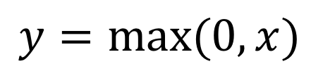
Activation Layer
Activation layer will bring nonlinear output.
ReLU:
$$y=max⁡(0, x)$$

Slide 7
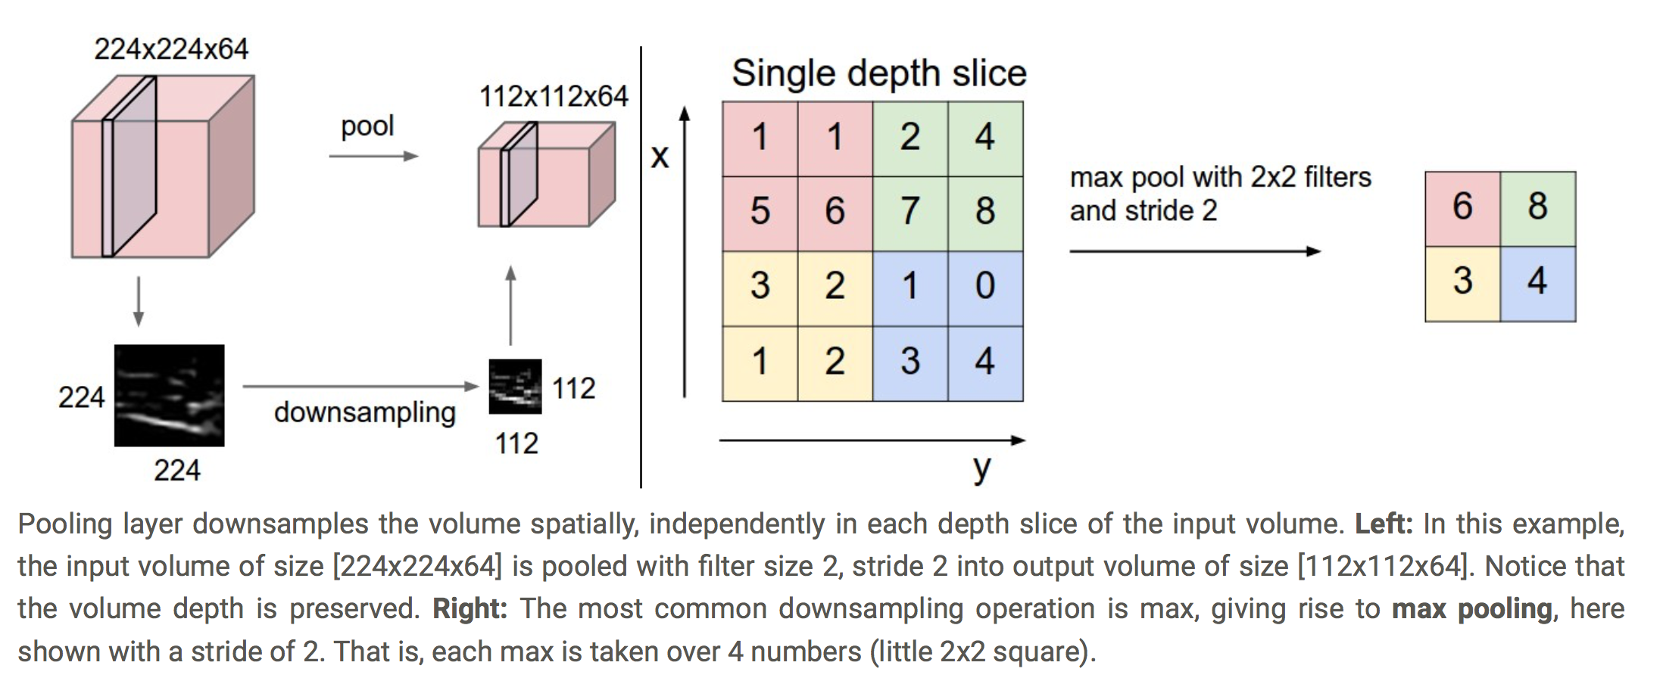
Pooling Layer

Slide 8
Fully-Connected Layer
Just simple MLP

Slide 9
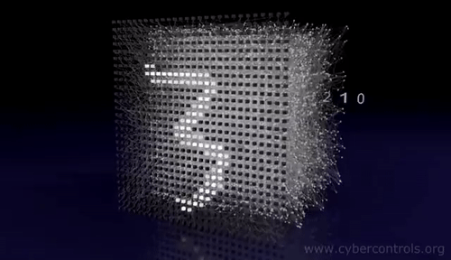
Digit Recognition

Slide 10
LeNet - 5

Slide 11
LeNet - 5

Slide 12
LeNet - 5

Slide 13
LeNet - 5

Slide 14
LeNet - 5

Slide 15
LeNet - 5

Slide 16
LeNet - 5

Slide 17
Build Lenet-5 model
# Task:
Finish the Lenet-5 building block.
The skeleton code is on canvas.

Slide 18
Build Lenet-5 model
# First Convolutional Layer with Tanh activation
29 model.add(Conv2D(filters=6, kernel_size=(5,5), padding='valid', input_shape=(28,28, 1), , activation='tanh'))

Slide 19
Build Lenet-5 model
# First MaxPooling Layer
31 model.add(MaxPool2D(pool_size=(2,2)))

Slide 20
Build Lenet-5 model
# Second Convolutional Layer with Tanh activation
33 model.add(Conv2D(filters=16, kernel_size=(5,5), padding='valid', activation='tanh'))

Slide 21
Build Lenet-5 model
# Second MaxPooling Layer with Relu activation
35 model.add(MaxPool2D(pool_size=(2,2)))

Slide 22
Build Lenet-5 model
# Add Fully-connected Layer
37 model.add(Flatten())
38 model.add(Dense(120, activation='tanh'))
39 model.add(Dense(84, activation='tanh'))

Slide 23
Build Lenet-5 model
# Add classifier Layer
41 model.add(Dense(10, activation='softmax'))

Slide 24
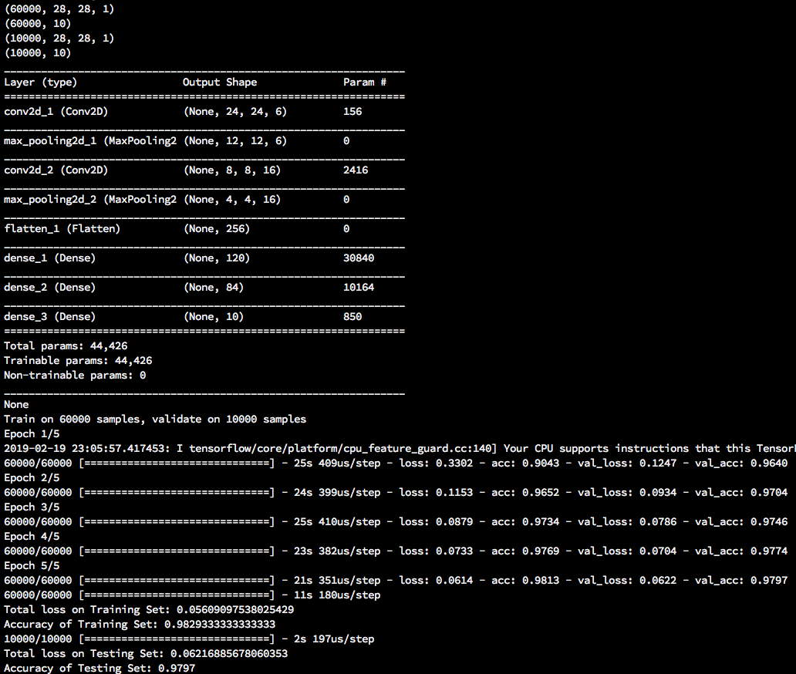
Test Your Code
$ python tut2_skeleton.py
Done!

Slide 25
Thank You

